Slide 1
Advanced Databases Lecture 12: Towards NOSQL data repositories
Dr. Pierpaolo Dondio,

Slide 2
SQL first

Slide 3
SQL Characteristics
Data stored in columns and tables
Relationships represented by data
Data Manipulation Language
Data Definition Language
Transactions (ACID)
Abstraction from physical layer

Slide 4
Data Manipulation Language (DML)
Data manipulated with Select, Insert, Update, & Delete statements
Select T1.Column1, T2.Column2 … From Table1, Table2 … Where T1.Column1 = T2.Column1 …
Data Aggregation
Functions and Procedures
Explicit transaction control

Slide 5
Data Definition Language
Schema defined at the start
Create Table (Column1 Datatype1, Column2 Datatype 2, …)
Constraints to define and enforce relationships
Primary Key
Foreign Key
Etc.
Triggers to respond to Insert, Update , & Delete
Stored Modules
Alter …
Drop …
Security and Access Control

Slide 6
NO SQL.. Why?

Slide 7
History of the World, Part 1
Web-based applications caused spikes
Especially true for public-facing e-Commerce sites
Internet, distributed data, big data…
Developers begin to front RDBMS with memcache or integrate other caching mechanisms within the application
Notes:
-> For the longest time (and still true today), the big relational database vendors such as Oracle, IBM, Sybase, and a lesser extent Microsoft were the mainstay of how data was stored.
-> During the Internet boom, startups looking for low-cost RDBMS alternatives turned to MySQL and PostgreSQL.
-> The ‘Slashdot Effect’ occurs when a popular website links to a smaller site, causing a massive increase in traffic.
-> Hooking your RDBMS to a web-based application was a recipe for headaches, they are OLTP in nature. Could have hundreds of thousands of visitors in a short-time span.
-> To mitigate, began to front the RDBMS with a read-only cache such as memcache to offload a considerable amount of the read traffic.
-> As datasets grew, the simple memcache/MySQL model (for lower-cost startups) started to become problematic.

Slide 8
Scaling Up
Issues with scaling up when the dataset is just too big
RDBMS were not designed to be distributed
Began to look at multi-node database solutions
Known as ‘scaling out’ or ‘horizontal scaling’
Different approaches include:
Master-slave
Sharding
Notes:
-> Best way to provide ACID and a rich query model is to have the dataset on a single machine.
-> However, there are limits to scaling up (Vertical Scaling).
-> Past a certain point, an organization will find it is cheaper and more feasible to scale out (horizontal scaling) by adding smaller, more inexpensive (relatively) servers rather than investing in a single larger server.
-> A number of different approaches to scaling out (Horizontal Scaling).
-> DBAs began to look at master-slave and sharding as a strategy to overcome some of these issues.

Slide 9
Scaling RDBMS – Master/Slave
Master-Slave
All writes are written to the master. All reads performed against the replicated slave databases
Critical reads may be incorrect as writes may not have been propagated down
Large data sets can pose problems as master needs to duplicate data to slaves

Slide 10
Scaling RDBMS - Sharding
Partition or sharding
Scales well for both reads and writes
Not transparent, application needs to be partition-aware
Can no longer have relationships/joins across partitions
Loss of referential integrity across shards

Slide 11
Other ways to scale RDBMS
No JOINs, thereby reducing query time
This involves de-normalizing data
In-memory databases
NO SQL started with the aim to address the scaling problem

Slide 12
NoSQL Definition
Next Generation Databases mostly addressing some of the points: being non-relational, distributed, open-source and horizontal scalable. The original intention has been modern web-scale databases. The movement began early 2009 and is growing rapidly. Often more characteristics apply as: schema-free, easy replication support, simple API, eventually consistent / BASE (not ACID), a huge data amount, and more.

Slide 13
What is NoSQL?
Stands for Not Only SQL
Class of non-relational data storage systems
Class of data management systems inherently
Non-relational
Distributed
Horizontally scalable
With optional schemas
Providing simple APIs
All NoSQL offerings relax one or more of the ACID properties
Notes:
-> NoSQL was a term coined by Eric Evans. He states that ‘… but the whole point of seeking alternatives is that you need to solve a problem that relational databases are a bad fit for. …
-> This is why people are continually interpreting nosql to be anti-RDBMS, it's the only rational conclusion when the only thing some of these projects share in common is that they are not relational databases.’
-> Emil Elfrem stated it is not a ‘NO’ SQL but more of a ‘Not Only” SQL.

Slide 14
NoSQL Distinguishing Characteristics
Large data volumes
“big data”
Scalable replication and distribution
Potentially thousands of machines
Potentially distributed around the world
Queries need to return answers quickly
Mostly query, few updates
Asynchronous Inserts & Updates
Schema-less
ACID transaction properties are not needed – BASE
CAP Theorem
Open source development

Slide 15
CAP THEOREM

Slide 16
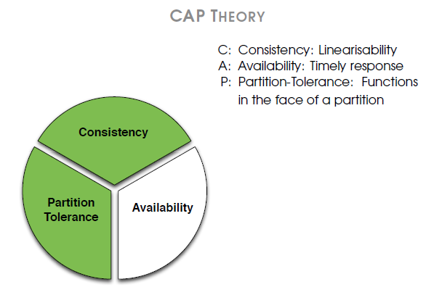
CAP Theory
2 out of 3!!!

Slide 17
CAP Theorem
Consistency – all nodes should see the same data at the same time
Availability – node failures do not prevent survivors continuing to operate
Partition-Tolerance – the system continues to operate despite arbitrary message loss, No set of failures less than total network failure is allowed to cause the system to respond incorrectly
It is impossible for a distributed systems to provide all of the above features (E. Brewer, 2000)

Slide 18
2 Out of 3: BASE vs ACID
C+A
Always available and consistent
Single site databases
Cluster Databases (why?)
C+P
Distributed Databases
Minority Locking
System is unavailable for a while..
A+P
DNS
BASE -

Slide 19
ACID properties apply to all transactions
Basic (ACID) properties of a transaction are:
Atomicity ‘All or nothing’ property.
Consistency Must transform database from one consistent state to another.
Isolation Partial effects of incomplete transactions should not be visible to other transactions.
Durability Effects of a committed transaction are permanent and must not be lost because of later failure.

Slide 20
BASE Transactions
Acronym contrived to be the opposite of ACID
Basically Available,
Soft state,
Eventually Consistent
Characteristics
Weak consistency – stale data OK
Availability first
Best effort
Approximate answers OK
Simpler and faster

Slide 21
BASE
When no updates occur for a long period of time, eventually all updates will propagate through the system and all the nodes will be consistent
For a given accepted update and a given node, eventually either the update reaches the node or the node is removed from service
Known as BASE (Basically Available, Soft state, Eventual consistency), as opposed to ACID
Notes:
-> http://en.wikipedia.org/wiki/Eventual_consistency
-> http://www.allthingsdistributed.com/2008/12/eventually_consistent.html
The types of large systems based on CAP aren't ACID they are BASE (http://queue.acm.org/detail.cfm?id=1394128): * Basically Available - system seems to work all the time * Soft State - it doesn't have to be consistent all the time * Eventually Consistent - becomes consistent at some later time
Everyone who builds big applications builds them on CAP and BASE: Google, Yahoo, Facebook, Amazon, eBay, etc

Slide 22
What am I giving up using NoSQL?
joins
group by
order by
ACID transactions
SQL as a sometimes frustrating but still powerful query language
easy integration with other applications that support SQL
Notes:
-> No JDBC
-> Data integrity at the application layer

Slide 23
Advantages of NoSQL
Cheap, easy to implement
Data are replicated and can be partitioned
Easy to distribute
Don't require a schema
Can scale up and down
Quickly process large amounts of data
Relax the data consistency requirement (CAP)
Can handle web-scale data, whereas Relational DBs cannot

Slide 24
NoSQL: Advantages /2
Simple APIs
Java Example: Document.save(myObject)
Good integration
Designed to be horizontally scalable (elastic)
Flexible data model
Majority free and/or Open Source
Free and Commercial production support

Slide 25
RDBMS Advantages (don’t forget!)
Proven
Available talent / Well-known
AD-Hoc querying
Scalable (limits?)
Free and Commercial production support

Slide 26
Disadvantages of NoSQL
New and sometimes buggy
Data is generally duplicated, potential for inconsistency
No standardized schema
No standard format for queries
No standard language
Difficult to impose complicated structures
Depend on the application layer to enforce data integrity
No guarantee of support
Too many options, which one, or ones to pick

Slide 27
Where would I use it?
Where would I use a NoSQL database?
Do you have somewhere a large set of uncontrolled, unstructured, data that you are trying to fit into a RDBMS?
Log Analysis
Social Networking Feeds (many firms hooked in through Facebook or Twitter)
External feeds from partners (EAI)
Data that is not easily analyzed in a RDBMS such as time-based data
Large data feeds that need to be massaged before entry into an RDBMS
Notes:
http://www.infoq.com/articles/nosql-in-the-enterprise

Slide 28
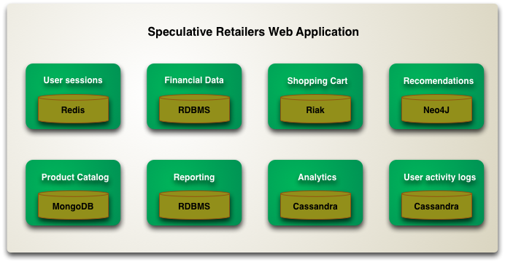
Hybrid approach: Polyglot Persistence
Using different DB technologies for different storage requirements
http://martinfowler.com/bliki/PolyglotPersistence.html

Slide 29
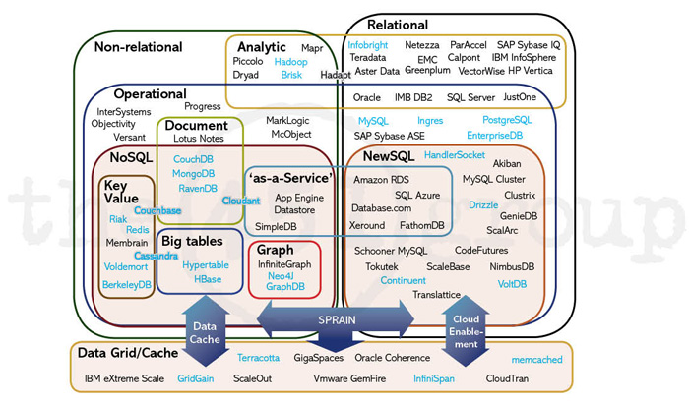
/

Slide 30

Intro to MongoDB

Slide 31
MongoDB profile
Document-oriented NoSQL database.
Schema-free.
Based on Binary JSON; BSON[2].
Organized in Group of Documents → Collections
Informal namespacing
Auto-Sharding in order to scale horizontally.
Simple query language. Rich, document-based queries.
Map/Reduce support (See more at [7]).
Open Source (GNU AGPL v3.0.)

Slide 32
Motivations
Problems with SQL
Rigid schema
Not easily scalable (designed for 90’s technology or worse)
Requires unintuitive joins
Benefits of mongoDB
Easy interface with common languages (Java, Javascript, PHP, etc.)
DB tech should run anywhere (VM’s, cloud, etc.)
Keeps essential features of RDBMS’s while learning from key-value noSQL systems
Notes:
Quotes from a person

Slide 33
Data Model
Document-Based (max 16 MB)
Documents are in BSON format, consisting of field-value pairs
Each document stored in a collection
Collections
Have index set in common
Like tables of relational db’s.
Documents do not have to have uniform structure

Slide 34
JSON
“JavaScript Object Notation”
Easy for humans to write/read, easy for computers to parse/generate
Objects can be nested
Built on
name/value pairs
Ordered list of values
http://json.org/

Slide 35
BSON
“Binary JSON”
Binary-encoded serialization of JSON-like docs
Also allows “referencing”
Embedded structure reduces need for joins
Goals
Lightweight
Traversable
Efficient (decoding and encoding)
http://bsonspec.org/

Slide 36
BSON Example
{
"_id" : "37010"
"city" : "ADAMS",
"pop" : 2660,
"state" : "TN",
“councilman” : {
name: “John Smith”
address: “13 Scenic Way”
}
}

Slide 37
The _id Field
By default, each document contains an _id field. This field has a number of special characteristics:
Value serves as primary key for collection.
Value is unique, immutable, and may be any non-array type.
Default data type is ObjectId, which is “small, likely unique, fast to generate, and ordered.” Sorting on an ObjectId value is roughly equivalent to sorting on creation time.
http://docs.mongodb.org/manual/reference/bson-types/

Slide 38
mongoDB vs. SQL
mongoDB | SQL
Document | Tuple
Collection | Table/View
PK: _id Field | PK: Any Attribute(s)
Uniformity not Required | Uniform Relation Schema
Index | Index
Embedded Structure | Joins
Shard | Partition

Slide 39
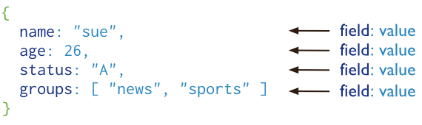
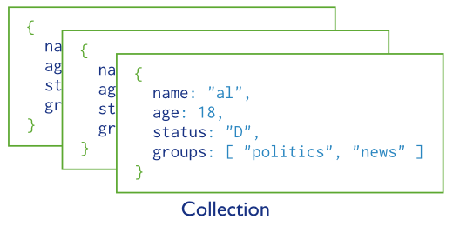
Basic operations
users

Slide 40
Data type
String − This is the most commonly used datatype to store the data. String in MongoDB must be UTF-8 valid.
Integer − This type is used to store a numerical value. Integer can be 32 bit or 64 bit depending upon your server.
Boolean − This type is used to store a boolean (true/ false) value.
Double − This type is used to store floating point values.
Min/ Max keys − This type is used to compare a value against the lowest and highest BSON elements.
Arrays − This type is used to store arrays or list or multiple values into one key.
Timestamp − ctimestamp. This can be handy for recording when a document has been modified or added.
Object − This datatype is used for embedded documents.

Slide 41
Data Type
Null − This type is used to store a Null value.
Symbol − This datatype is used identically to a string; however, it's generally reserved for languages that use a specific symbol type.
Date − This datatype is used to store the current date or time in UNIX time format. You can specify your own date time by creating object of Date and passing day, month, year into it.
Object ID − This datatype is used to store the document’s ID.
Binary data − This datatype is used to store binary data.
Code − This datatype is used to store JavaScript code into the document.
Regular expression − This datatype is used to store regular expression.

Slide 42
Logical tests
Operation | Syntax | Example | RDBMS Equivalent
Equality | {<key>:<value>} | db.mycol.find({"by":"tutorials point"}).pretty() | where by = 'tutorials point'
Less Than | {<key>:{$lt:<value>}} | db.mycol.find({"likes":{$lt:50}}).pretty() | where likes < 50
Less Than Equals | {<key>:{$lte:<value>}} | db.mycol.find({"likes":{$lte:50}}).pretty() | where likes <= 50
Greater Than | {<key>:{$gt:<value>}} | db.mycol.find({"likes":{$gt:50}}).pretty() | where likes > 50
Greater Than Equals | {<key>:{$gte:<value>}} | db.mycol.find({"likes":{$gte:50}}).pretty() | where likes >= 50
Not Equals | {<key>:{$ne:<value>}} | db.mycol.find({"likes":{$ne:50}}).pretty() | where likes != 50

Slide 43
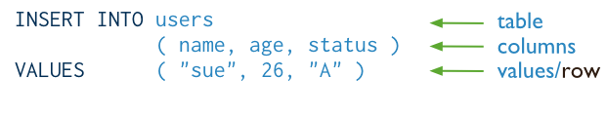
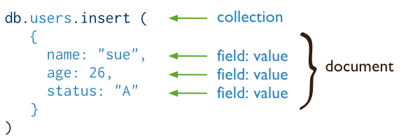
CRUD operations - create
Insert a new user.
SQL
MongoDB

Slide 44
The _id field
_id is a 12 bytes hexadecimal number which assures the uniqueness of every document.
You can provide _id while inserting the document. If you don’t provide then MongoDB provides a unique id for every document.
These 12 bytes first 4 bytes for the current timestamp, next 3 bytes for machine id, next 2 bytes for process id of MongoDB server and remaining 3 bytes are simple incremental VALUE.

Slide 45
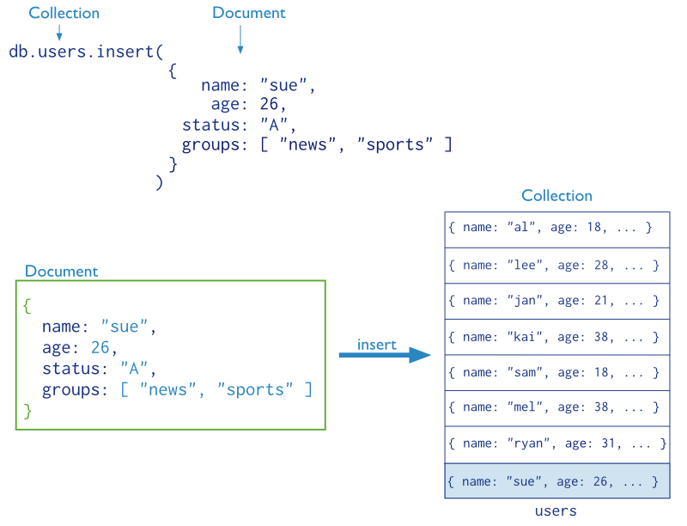
CRUD operations – create (cont’d)

Slide 46
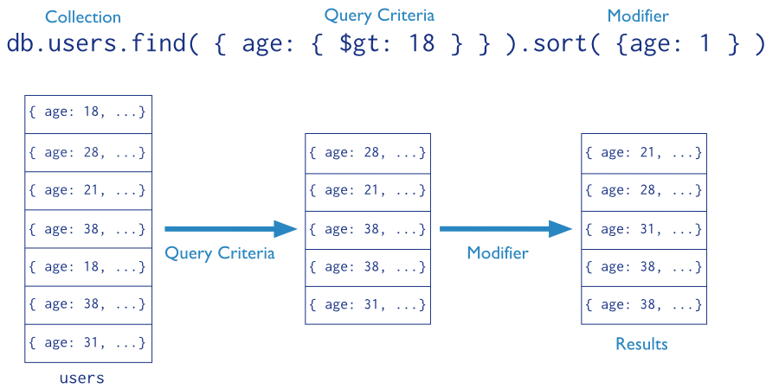
CRUD operations - read
Find the users of age greater than 18 and sort by age.

Slide 47
Querying
OR
db.<collection>.find({ $or: [
<field>:<value1>
<field>:<value2> ]
})
SELECT *
FROM <table> WHERE <field> = <value1> OR <field> = <value2>;
Checking for multiple values of same field
db.<collection>.find({<field>: {$in [<value>, <value>]}})

Slide 48

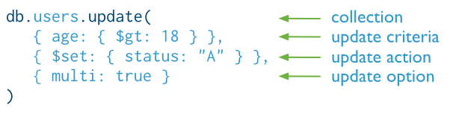
CRUD operations - update
Update the users of age greater than 18 by setting the status field to A.
SQL
MongoDB

Slide 49

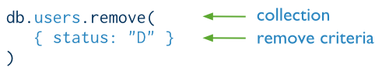
CRUD operations - delete
Delete the users with status equal to D.
SQL
MongoDB

Slide 50
Schema Design

Slide 51
SQL vs Mongo Concepts
RDBMS |  | MongoDB
Database | ➜ | Database
Table | ➜ | Collection
Row | ➜ | Document
Index | ➜ | Index
Join | ➜ | Embedded Document
Foreign Key | ➜ | Reference

Slide 52
Mongo is basically schema-free
The purpose of schema in SQL is for meeting the requirements of tables and SQL implementation
Every “row” in a database “table” is a data structure, much like a “struct” in C, or a “class” in Java. A table is then an array (or list) of such data structures
So we what we design in mongoDB is basically same way how we design a compound data type binding in JSON

Slide 53
There are some patterns
Embedding Embed the document into the other document
Similar to denormalized joins
Linking (also known as reference)
Use the id of a document as a field in another document
similar to a FK in SQL

Slide 54
One to One relationship - embedding
zip = {
_id: 35004,
city: “ACMAR”,
loc: [-86, 33],
pop: 6065,
State: “AL”
}
council_person = {
zip_id = 35004,
name: “John Doe",
address: “123 Fake St.”,
Phone: 123456
}
zip = {
_id: 35004 ,
city: “ACMAR”
loc: [-86, 33],
pop: 6065,
State: “AL”,
council_person: {
name: “John Doe",
address: “123 Fake St.”,
Phone: 123456
}
}

Slide 55
One to many relationship - embedding
book = {
title: "MongoDB: The Definitive Guide",
authors: [ "Kristina Chodorow", "Mike Dirolf" ]
published_date: ISODate("2010-09-24"),
pages: 216,
language: "English",
publisher: {
name: "O’Reilly Media",
founded: "1980",
location: "CA” }
}

Slide 56
One to many relationship – Linking
publisher = {
_id: "oreilly",
name: "O’Reilly Media",
founded: "1980",
location: "CA"}
book = {
title: "MongoDB: The Definitive Guide",
authors: [ "Kristina Chodorow", "Mike Dirolf" ]
published_date: ISODate("2010-09-24"),
pages: 216,
language: "English",
publisher_id: "oreilly"}

Slide 57
Linking vs. Embedding
Embedding is a bit like pre-joining data
Document level operations are easy for the server to handle
Embed when the “many” objects always appear with (viewed in the context of) their parents.
Linking when you need more flexibility, less redundancy

Slide 58
Modeling Checkouts
student = {
_id: "joe"
name: "Joe Bookreader",
join_date: ISODate("2011-10-15"),
address: { ... }
}
book = {
_id: "123456789"
title: "MongoDB: The Definitive Guide",
authors: [ "Kristina Chodorow", "Mike Dirolf" ],
...
}

Slide 59
Modeling Checkouts
student = {
_id: "joe"
name: "Joe Bookreader",
join_date: ISODate("2011-10-15"),
address: { ... },
checked_out: [
{ _id: "123456789", checked_out: "2012-10-15" },
{ _id: "987654321", checked_out: "2012-09-12" },
...
]
}

Slide 60
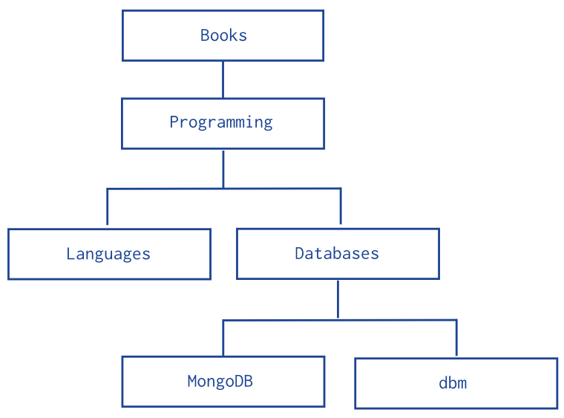
Model Tree Structure
db.categories.insert( { _id: "MongoDB", parent: "Databases" } ) db.categories.insert( { _id: "dbm", parent: "Databases" } ) db.categories.insert( { _id: "Databases", parent: "Programming" } ) db.categories.insert( { _id: "Languages", parent: "Programming" } ) db.categories.insert( { _id: "Programming", parent: "Books" } ) db.categories.insert( { _id: "Books", parent: null } )
db.categories.findOne( { _id: "MongoDB" } ).parent
db.categories.ensureIndex( { parent: 1 } )
db.categories.find( { parent: "Databases" } )

Slide 61
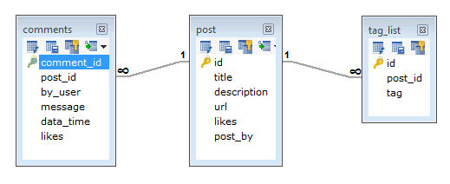
Another Example
Suppose a client needs a database design for his blog/website and see the differences between RDBMS and MongoDB schema design. Website has the following requirements.
Every post has the unique title, description and url.
Every post can have one or more tags.
Every post has the name of its publisher and total number of likes.
Every post has comments given by users along with their name, message, data-time and likes.
On each post, there can be zero or more comments.

Slide 62
MongoDB Document
{
_id: POST_ID
title: TITLE_OF_POST,
description: POST_DESCRIPTION,
by: POST_BY,
url: URL_OF_POST,
tags: [TAG1, TAG2, TAG3],
likes: TOTAL_LIKES,
comments: [
{
user:'COMMENT_BY',
message: TEXT,
dateCreated: DATE_TIME,
like: LIKES
},
{
user:'COMMENT_BY',
message: TEXT,
dateCreated: DATE_TIME,
like: LIKES
}
]
}

Slide 63
Some considerations while designing Schema in MongoDB
Design your schema according to user requirements.
Combine objects into one document if you will use them together. Otherwise separate them (but make sure there should not be need of joins).
Duplicate the data (but limited) because disk space is cheap as compare to compute time.
Do joins while write, not on read.
Optimize your schema for most frequent use cases.
Do complex aggregation in the schema.

Slide 64
Index in MongoDB

Slide 65
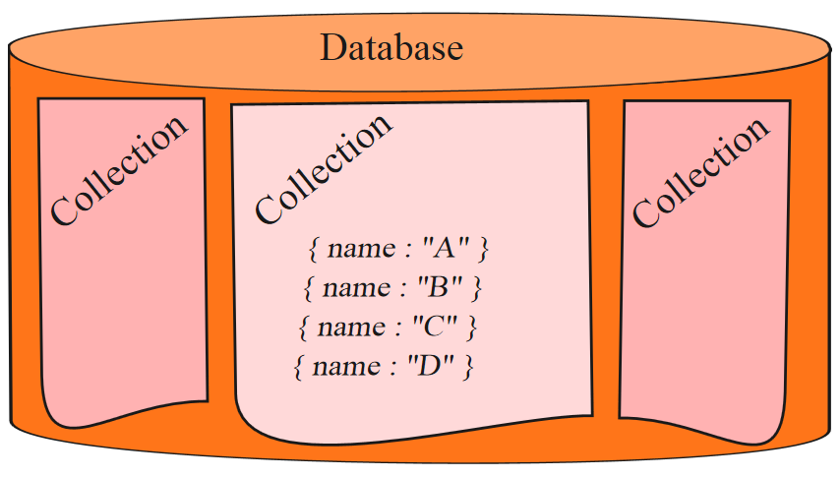

Before Index
What does database normally do when we query?
MongoDB must scan every document.
Inefficient because process large volume of data
db.users.find( { score: { “$lt” : 30} } )

Slide 66
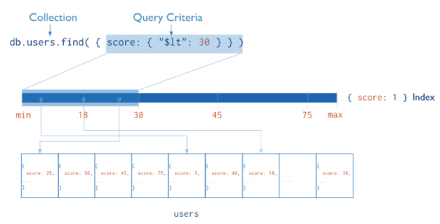
Definition of Index
Definition
Indexes are special data structures that store a small portion of the collection’s data set in an easy to traverse form.
Index
Diagram of a query that uses an index to select

Slide 67
Index in MongoDB
Creation index
db.users.ensureIndex( { score: 1 } )
Show existing indexes
db.users.getIndexes()
Drop index
db.users.dropIndex( {score: 1} )
Explain—Explain
db.users.find().explain()
Returns a document that describes the process and indexes

Slide 68
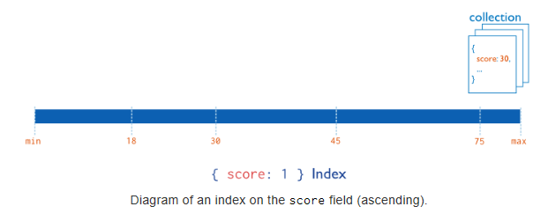
Index in MongoDB
Types
Single Field Indexes
Compound Field Indexes
Multikey Indexes
Single Field Indexes
db.users.ensureIndex( { score: 1 } )

Slide 69
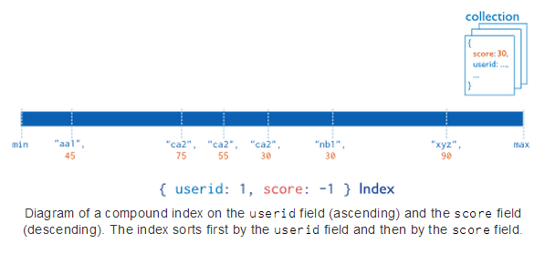
Index in MongoDB
Types
Single Field Indexes
Compound Field Indexes
Multikey Indexes
Compound Field Indexes
db.users.ensureIndex( { userid:1, score: -1 } )

Slide 70
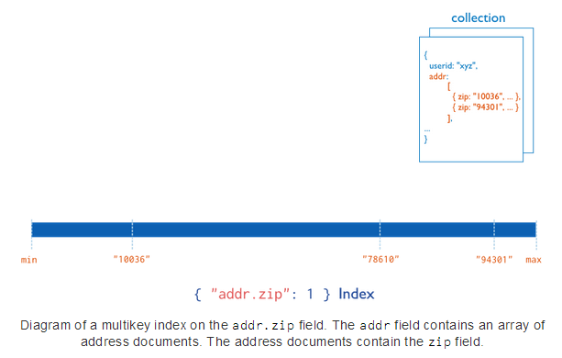
Index in MongoDB
Types
Single Field Indexes
Compound Field Indexes
Multikey Indexes
Multikey Indexes
db.users.ensureIndex( { addr.zip:1} )

Slide 71
Aggregation
Operations that process data records and return computed results.
MongoDB provides aggregation operations
Running data aggregation on the mongod instance simplifies application code and limits resource requirements.

Slide 72
Pipelines
MongoDB’s aggregation framework is modeled on the concept of data processing pipelines. Documents enter a multi-stage pipeline that transforms the documents into an aggregated result.
The most basic pipeline stages provide filters that operate like queries and document transformations that modify the form of the output document.
Other pipeline operations provide tools for grouping and sorting documents by specific field or fields as well as tools for aggregating the contents of arrayspipeline stages can use operators for tasks such as calculating the average or concatenating a string.
the preferred method for data aggregation in MongoDB.

Slide 73
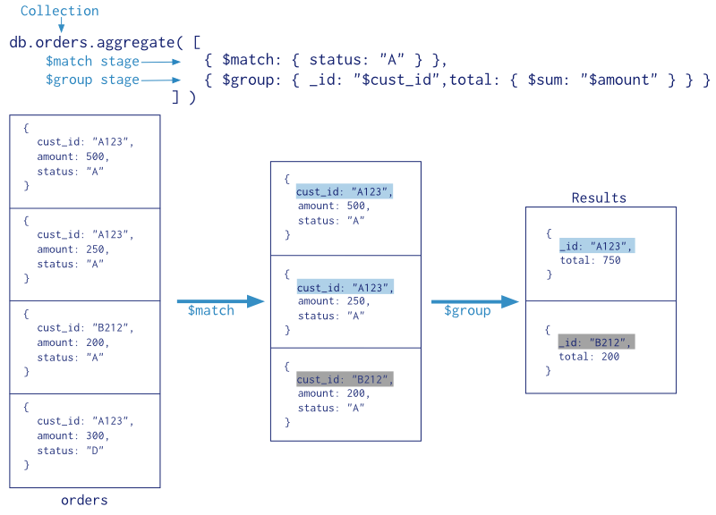
Aggregation using pipeline

Slide 74
Map Reduce
Algorithm (“template”) to perform distributed parallel computation
Used in MongoDB for performing distributed queries, for instance aggregated queries
MongoDB provides the function map-reduce
Map reduce is a concept from functional programming
map even [3,4,5,6,7,9] = [4,6]

Slide 75
Aggregator Operators
Expression | Description | Example
$sum | Sums up the defined value from all documents in the collection. | db.mycol.aggregate([{$group : {_id : "$by_user", num_tutorial : {$sum : "$likes"}}}])
$avg | Calculates the average of all given values from all documents in the collection. | db.mycol.aggregate([{$group : {_id : "$by_user", num_tutorial : {$avg : "$likes"}}}])
$min. $min | Gets the minimum of the corresponding values from all documents in the collection. | db.mycol.aggregate([{$group : {_id : "$by_user", num_tutorial : {$min : "$likes"}}}])
$push | Inserts the values to an array in the resulting document. | db.mycol.aggregate([{$group : {_id : "$by_user", url : {$push: "$url"}}}])
$addToSet | Inserts the value to an array in the resulting document but does not create duplicates. | db.mycol.aggregate([{$group : {_id : "$by_user", url : {$addToSet : "$url"}}}])
$first | Gets the first document from the source documents according to the grouping. Typically this makes only sense together with some previously applied “$sort”-stage. | db.mycol.aggregate([{$group : {_id : "$by_user", first_url : {$first : "$url"}}}])
$last | Gets the last document from the source documents according to the grouping. Typically this makes only sense together with some previously applied “$sort”-stage. | db.mycol.aggregate([{$group : {_id : "$by_user", last_url : {$last : "$url"}}}])

Slide 76
Map-Reduce
Has two phases:
A map stage that processes each document and emits one or more objects for each input document
A reduce phase that combines the output of the map operation.
An optional finalize stage for final modifications to the result
Uses Custom JavaScript functions
Provides greater flexibility but is less efficient and more complex than the aggregation pipeline
Can have output sets that exceed the 16 megabyte output limitation of the aggregation pipeline.

Slide 77
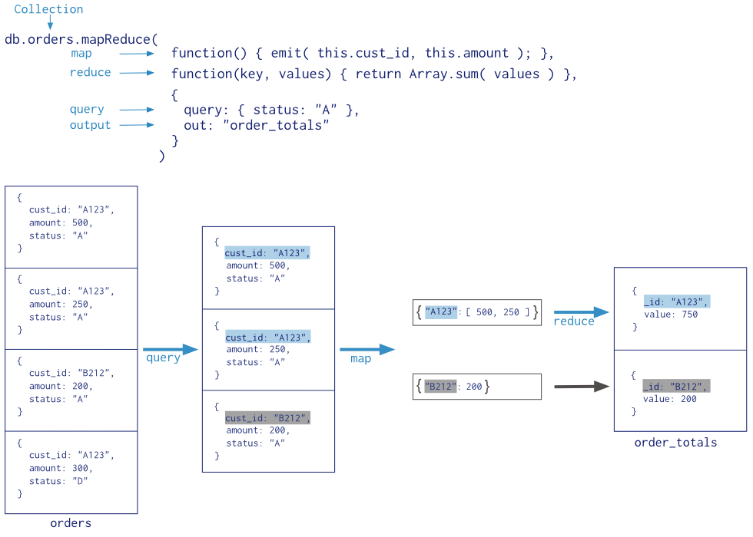
Map-Reduce Example

Slide 78
Map-reduce as JavaScript
In MongoDB, map-reduce operations use custom JavaScript functions to map, or associate, values to a key. If a key has multiple values mapped to it, the operation reduces the values for the key to a single object.

Slide 79
Map reduce in MongoDB
db.runCommand( { mapReduce: <collection>, map: <function>, reduce: <function>, out: <output>, query: <document>, sort: <document>, limit: <number>, finalize: <function>, scope: <document>, jsMode: <boolean>, verbose: <boolean> } )

Slide 80
Map function
function() { ... emit(key, value); }
The map function has the following requirements:
In the map function, reference the current document as this within the function.
The map function should not access the database for any reason.
The map function should be pure, or have no impact outside of the function (i.e. side effects.)
The map function may optionally call emit(key,value) any number of times to create an output document associating key with value.

Slide 81
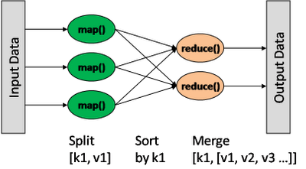
Map/Reduce
db.collection.mapReduce(
<mapfunction>,
<reducefunction>,
{
out: <collection>,
query: <>,
sort: <>,
limit: <number>,
finalize: <function>,
scope: <>,
jsMode: <boolean>,
verbose: <boolean>
} )
var mapFunction1 = function() { emit(this.cust_id, this.price); };
var reduceFunction1 = function(keyCustId, valuesPrices)
{ return sum(valuesPrices); };
Notes:
http://docs.mongodb.org/manual/reference/method/db.collection.mapReduce/#db.collection.mapReduce

Slide 82
